Slide 1


Vehicle Object & Number Plate Recognition, Text generation and Speed Measurement
Guide By :- Presented by:-
Mrs. Priti Take Group ID :- 26
Sachin Jain(248539)
Sanskar Jain(248543)
Utkarsh Pandey(248553)

Slide 2
Problem Statements
. Vehicle Number plate and object detection.
Number plate text generate by using Tesseract Optical Character Recognition (OCR).
Measure the vehicle’s speed using object Tracking.

Slide 3
Data Gathering & Pre-Processing
Data Sources:-
Kaggle and RoboFlow for Image Data
Image Labelling:-
Labelimg tool use for Image Annotation(Manually)

Slide 4
Flow Diagram
Data Gathering and Preprocessing
Model Generator
Object-Type and Number plate Detection
Text Generation
Speed Measurement

Slide 5
Libraries Uses
ultralytics – Provides YOLO models for object detection and tracking.
opencv-python – Handles image and video processing tasks.
pytesseract – Extracts text from images using OCR (Optical Character Recognition).
torch – PyTorch framework for deep learning and AI model training.
numpy – Handles numerical computations and matrix operations.
Pandas - Manages structured data using DataFrames for analysis.
pillow – Processes and manipulates images in Python.
matplotlib – Plots and visualizes data graphically.
ipython – Enhances interactive Python shell experience.
supervision – Provides tools for annotating and tracking objects in computer vision tasks.
byteTrack – Implements multi-object tracking using ByteTrack algorithm.

Slide 6
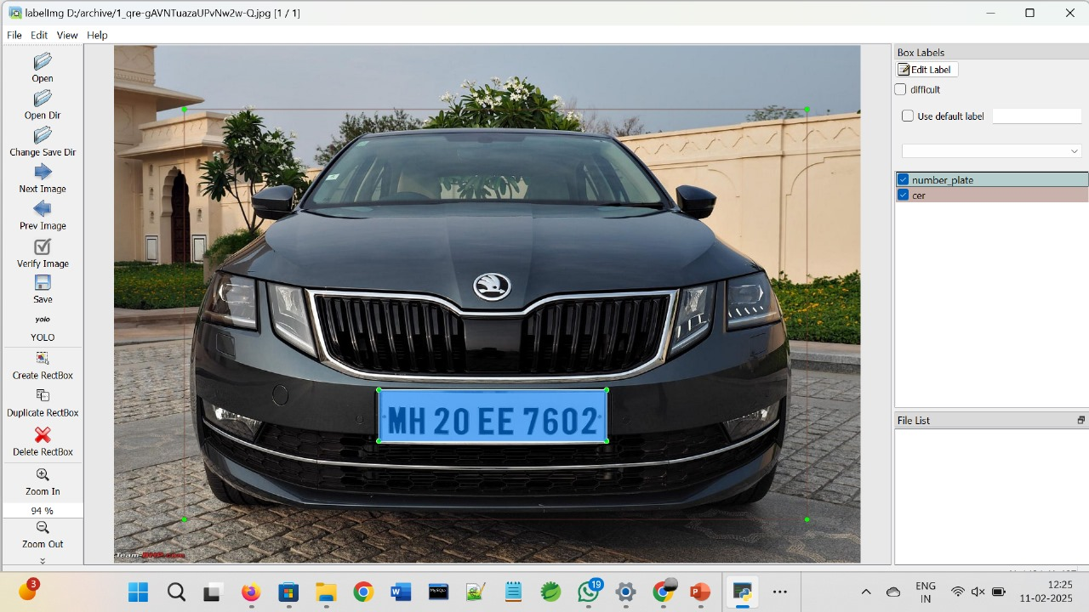
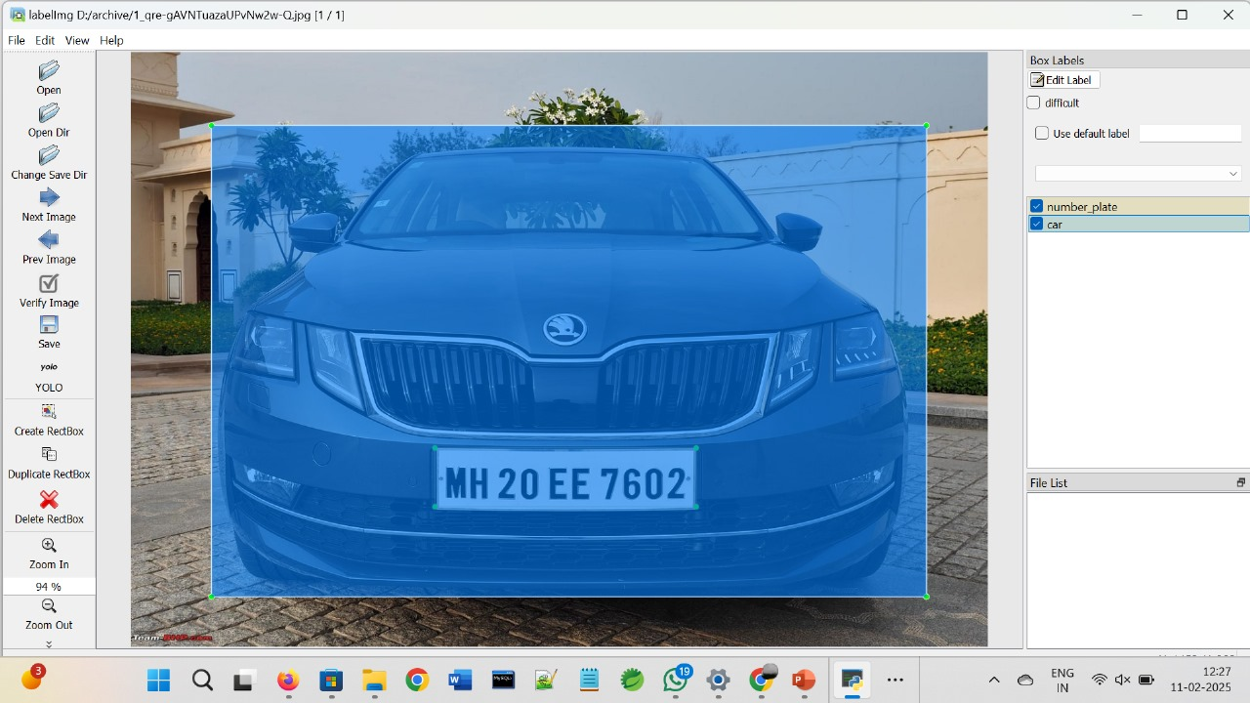
Image Labelling

Slide 7
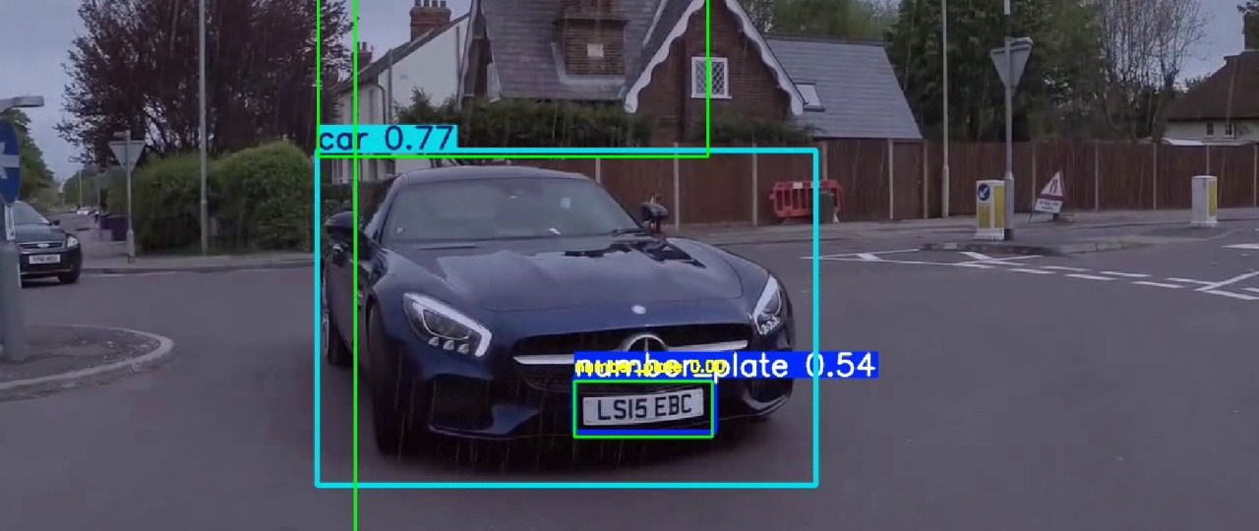
Vehicle-Type And Number plate Detection
Here we are trying to find out the vehicle-type and also detect the number plate only.

Slide 8
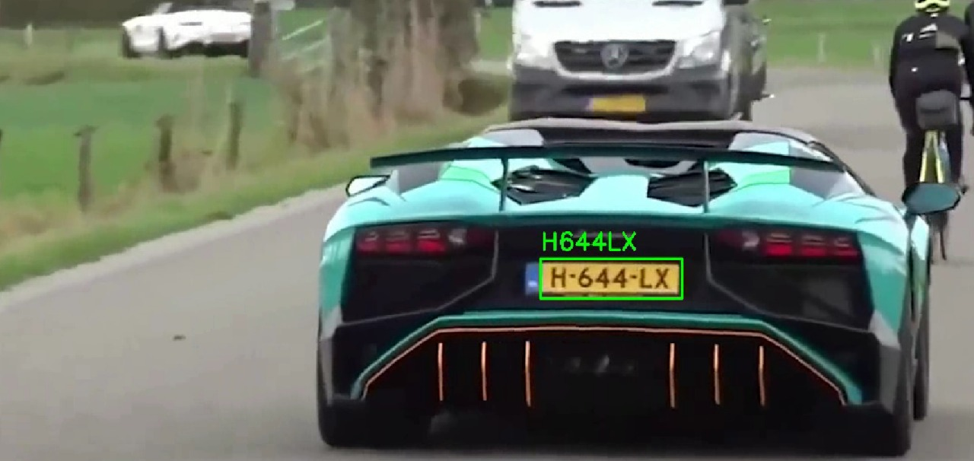
Text Generation for Number Plate
For number plate text generation, we use PyTesseract OCR, which extracts text from detected number plates. It processes cropped plate images, recognizes characters, and converts them into readable alphanumeric text.

Slide 9
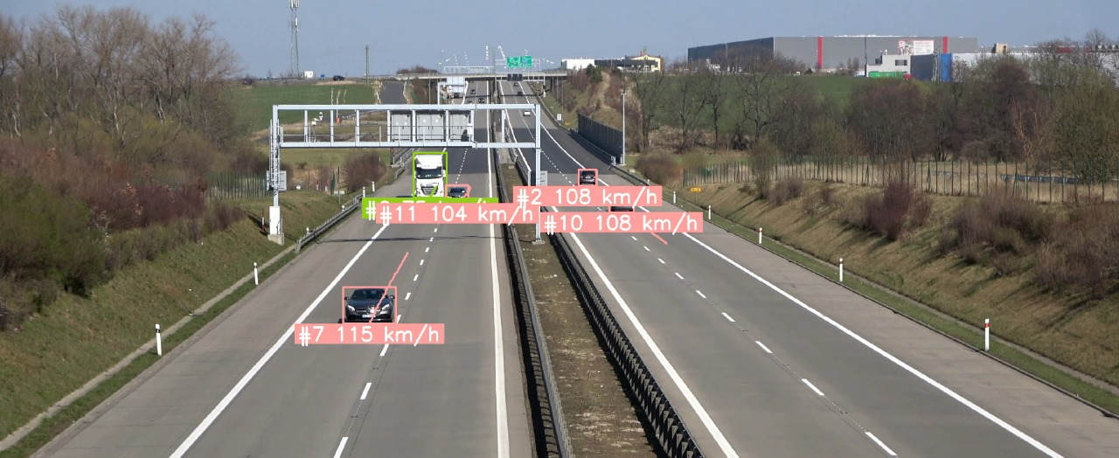
Speed Measurement
Speed measurement is done by tracking a vehicle's position across frames, calculating the distance moved, and dividing by the time taken. The result is converted to km/h using a scaling factor.

Slide 10
Future Enhancement
Future improvements could include better OCR accuracy, multi-lane tracking, and integration with databases for real-time reporting.
We will also use Kafka and Spark Streaming for real-time data processing and Airflow for workflow automation. The project can be deployed on cloud platforms like AWS, Render, or Google Colab for scalability.

Slide 11
Conclusion
In this project, we successfully implemented a vehicle detection, number plate recognition, and speed measurement system using YOLO, OpenCV, Tesseract OCR, and tracking algorithms. The system detects vehicles in a video, identifies their number plates, extracts text using OCR, and calculates their speed based on movement over time.
This system can help in traffic monitoring, speed violation detection, and smart city solutions.
Future improvements could include better OCR accuracy, multi-lane tracking, and integration with databases for real-time reporting.
We will also use Kafka and Spark Streaming for real-time data processing and Airflow for workflow automation. The project can be deployed on cloud platforms like AWS, Render, or Google Colab for scalability.

